Slide 1
A Cognitive Psychology Approach to Analyse Information using Machine Learning
Department of Computer Science and Engineering
By
Aryan Kumar 1MS22CS035
Basavaraj Bhajantri 1MS22CS041
Hariprasad B R 1MS22CS057
I Suprabhath Reddy 1MS22CS065
Under the Guidance of
Mrs Akshatha S Bayyar
Assistant Professor

Slide 2
Project Overview
This project develops an intelligent chatbot system that combines cognitive psychology principles with machine learning to create personalized interactions . The system analyzes user context, emotions, and personality traits to provide adaptive responses tailored to individual psychological profiles.
Objectives:
To develop a cognitive psychology-based user classification system that utilizes MBTI profiling and emotion analysis for accurate personality and state detection.
To implement a personalized response generation engine that adapts conversational style and support strategies based on detected emotional state, academic context, and user personality.
To enable cross-linguistic adaptation by providing culturally sensitive, emotion-aware responses in both English and Kannada, ensuring inclusivity and accessibility for regional language users.

Slide 3
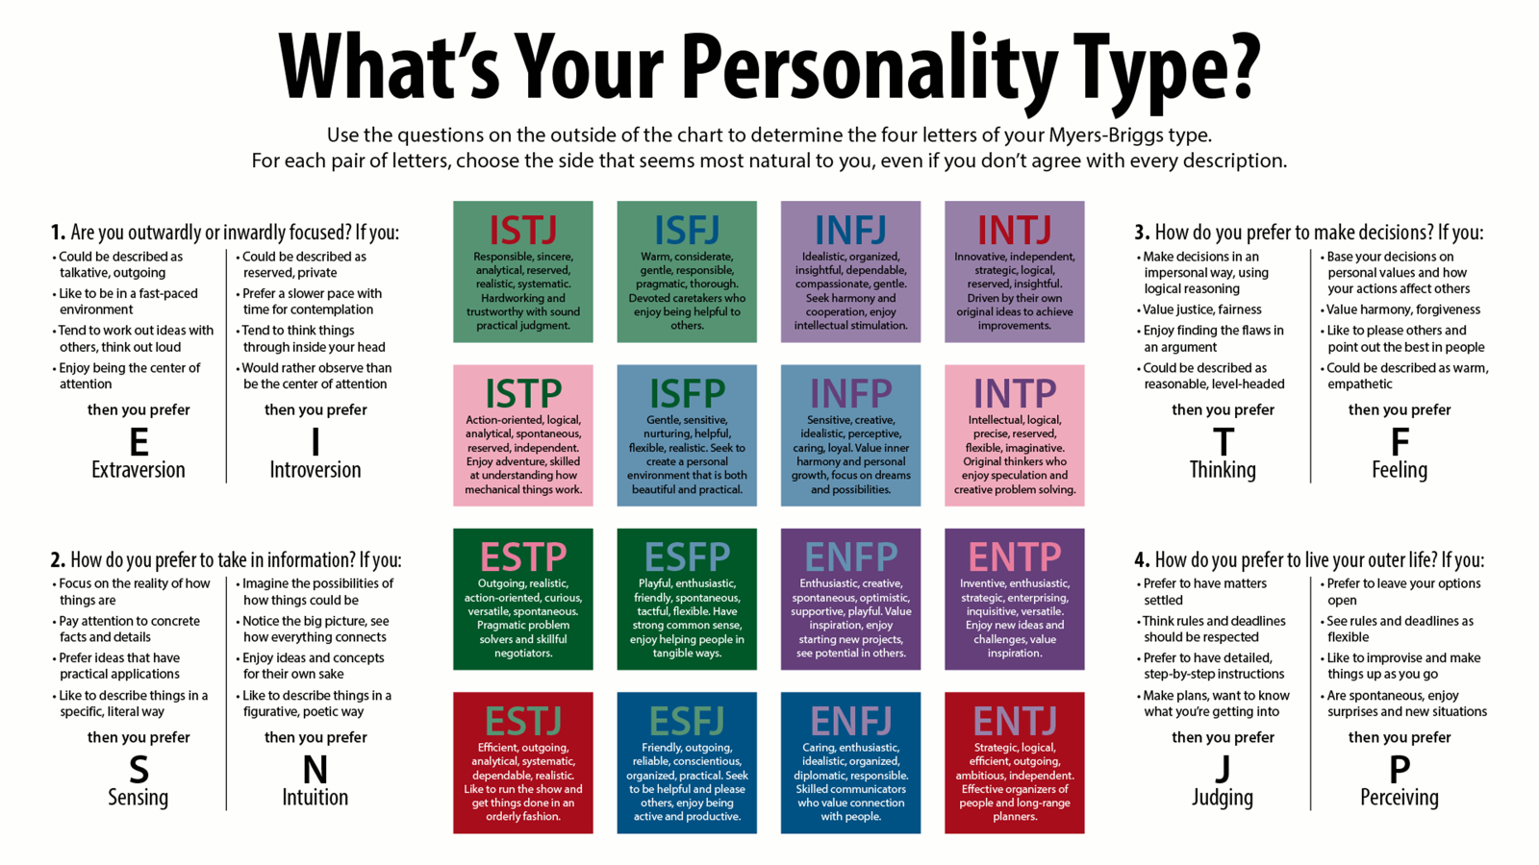

Slide 4
Literature Survey
Title, Author and Year | Technique/Methodology used | Result | Remarks
“Kannada NLP Toolkit: Building Tools for Low Resource Storage Languages”, Rao et al., 2019 | Rule-based + Statistical NLP for Kannada | Built basic NLP tools for Kannada | This paper addresses the lack of NLP tools for Kannada, a low-resource language. The toolkit lays the groundwork for more complex systems but has limited vocabulary and lacks contextual understanding. It highlights a research gap in creating deep learning-based or transformer-based models for Kannada NLP.
Emotion-Aware Chatbot Using Deep Learning Patel & Singh, 2020 | CNN + LSTM with emotion datasets | ~70% emotion detection accuracy | The paper presents a straightforward deep learning approach for emotion recognition in English text. Its simplicity makes it easy to implement, but it lacks multilingual capabilities and deeper context understanding. The study reveals a gap in adapting such architectures for low-resource or multilingual environments.

Slide 5
Literature Survey
Title, Author and Year | Technique/Methodology used | Result | Remarks
“Personalized Conversational Agents Using Hybrid AI Models”, Chen et al.,2022 | Rule-based + Machine Learning hybrid system | Generated responses tailored to user mood and context | The paper demonstrates how combining rule-based and ML techniques can lead to adaptive, context-aware chatbots. It effectively improves user interaction through emotion and state tracking. However, it lacks support for multiple languages and could be enhanced by integrating multilingual NLP models.
“Cross-Lingual Transfer Learning for Emotion Recognition”, Banerjee et al., 2021 | Cross-lingual BERT fine-tuning | Effective performance in emotion recognition for low-resource Indian languages | This study explores transfer learning with BERT to address low-resource language limitations. It proves that pre-trained multilingual models can generalize emotional understanding across languages. However, slight accuracy drop suggests a need for more domain-specific fine-tuning or supplementary training data.
“Personality-Aware Chatbot Using MBTI and Sentiment Analysis”, Verma et al., 2020 | Sentiment analysis + MBTI classification | Improved user engagement and trust | The paper integrates psychology-based user profiling (MBTI) with sentiment analysis to produce emotionally aligned responses. It enhances user satisfaction but may face scalability issues due to the complexity of real-time personality assessment. There's potential to combine this approach with adaptive learning techniques.

Slide 6
Identified Research Gaps
Lack of Dynamic Adaptation: Existing static, one-size-fits-all conversational AI systems often fail to dynamically adapt to users emotional states.
Limited Regional Language Support: There is an urgent need for accessible academic support tools for regional language speakers, such as Kannada, where culturally and emotionally aware AI support is largely absent.
Incomplete Integration: Few existing systems comprehensively integrate MBTI personality profiling, emotion detection, and multilingual support in a single framework.
Scaling and Practical Limitations:
  Many systems exploring empathetic dialogue generation lack deep personality modeling.
  Multi-modal systems (e.g., using voice or facial expressions) have been limited by hardware constraints or privacy concerns.

Slide 7
System Architecture
Architecture Overview
The system is designed in a layered modular structure, integrating user interaction, backend processing, AI-based prediction, emotional context detection, and personalized response generation using Gemini API.
Component Layers
User Interaction Layer: Contains LanguageSelector and Auth for multilingual login and language preference.
Detection Layer: Uses a hybrid MBTI Classifier (mBERT ) to predict the user’s personality type.
Context Detection Layer: Leverages DistilRoBERTa to detect emotional and academic context from the user’s messages.
Adaptation Layer: The Personality Adaptation Engine adjusts responses based on personality and emotional context.
Storage Layer:Stores chat history, personality data, and adaptation logs in the database.
Response Generation Layer: Gemini API generates intelligent, adaptive responses using emotion-aware prompts tailored to the user’s context and personality.

Slide 8
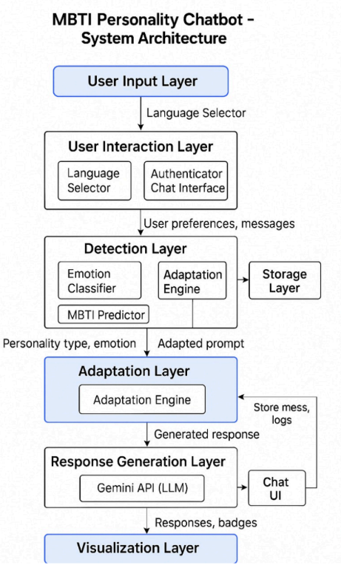

Slide 9
Implementation Approach
Tools & Technologies
Frontend: React.js, i18next (for multilingual UI), HTML/CSS, JSX
Backend: Flask (Python), RESTful APIs
ML Models:
  MBTI Prediction: mBERT
  Emotion Detection: DistilRoBERTa
  Adaptation: Custom Python engine
LLM Integration: Gemini API (Google Generative AI)
Database: MongoDB
Implementation Workflow
User selects language → stored in localStorage.
User signs up/logs in → data saved in MongoDB.
Chat starts or MBTI quiz is completed.
MBTI is predicted using mBERT → saved to profile.
User sends message → emotion & context detected via DistilRoBERTa.
Adaptation engine selects tone/style based on MBTI + emotion.
Prompt is constructed and passed to Gemini API.
Final adapted message is shown with MBTI + context badge.

Slide 10
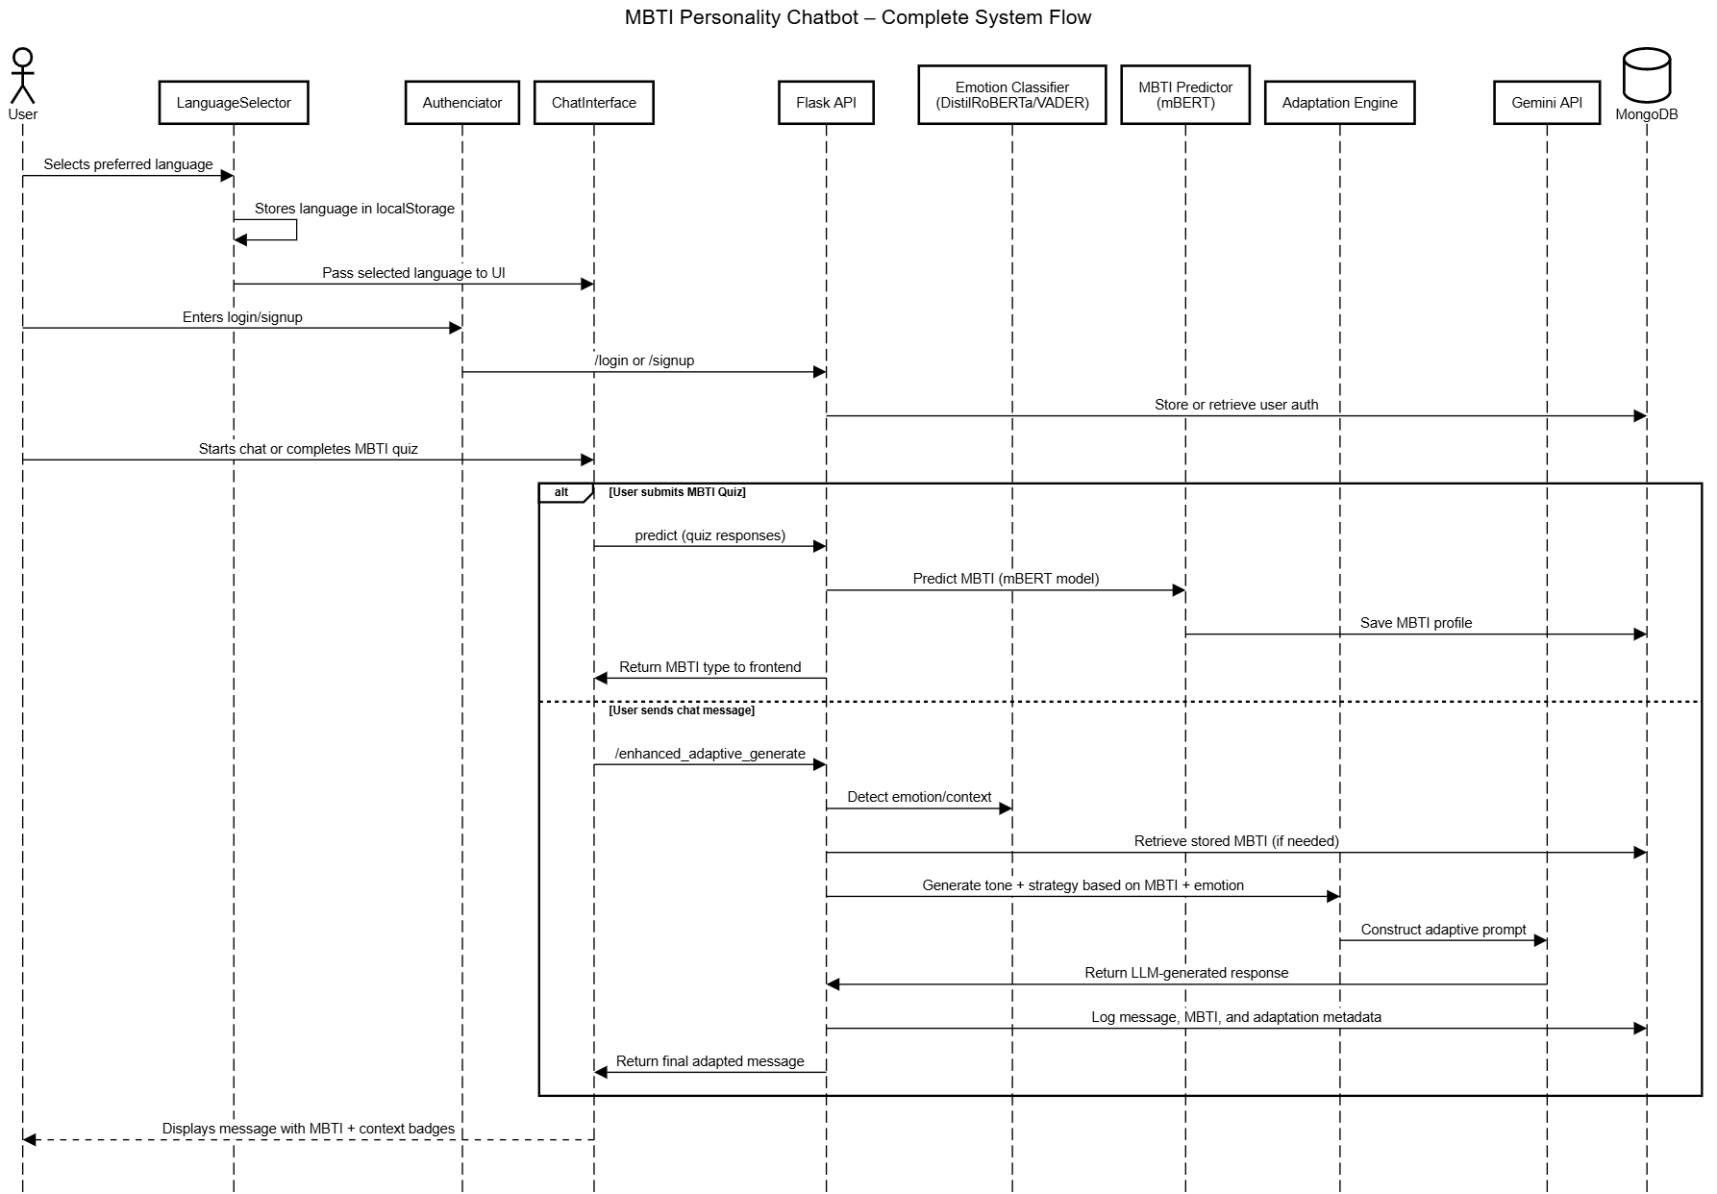

Slide 12
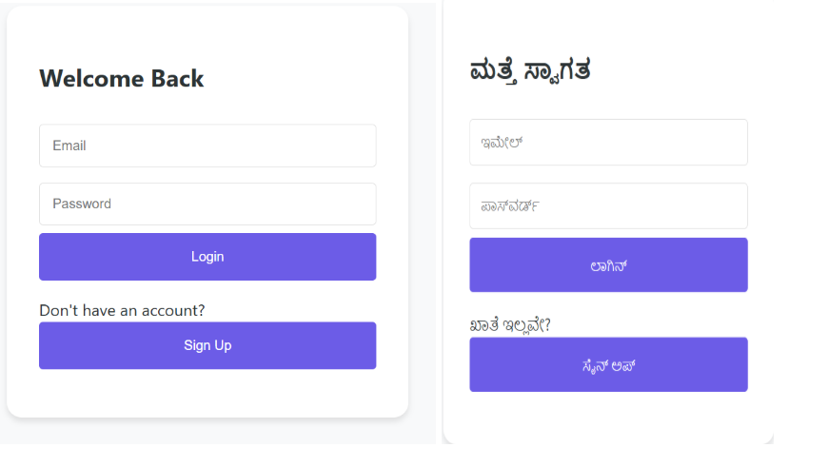
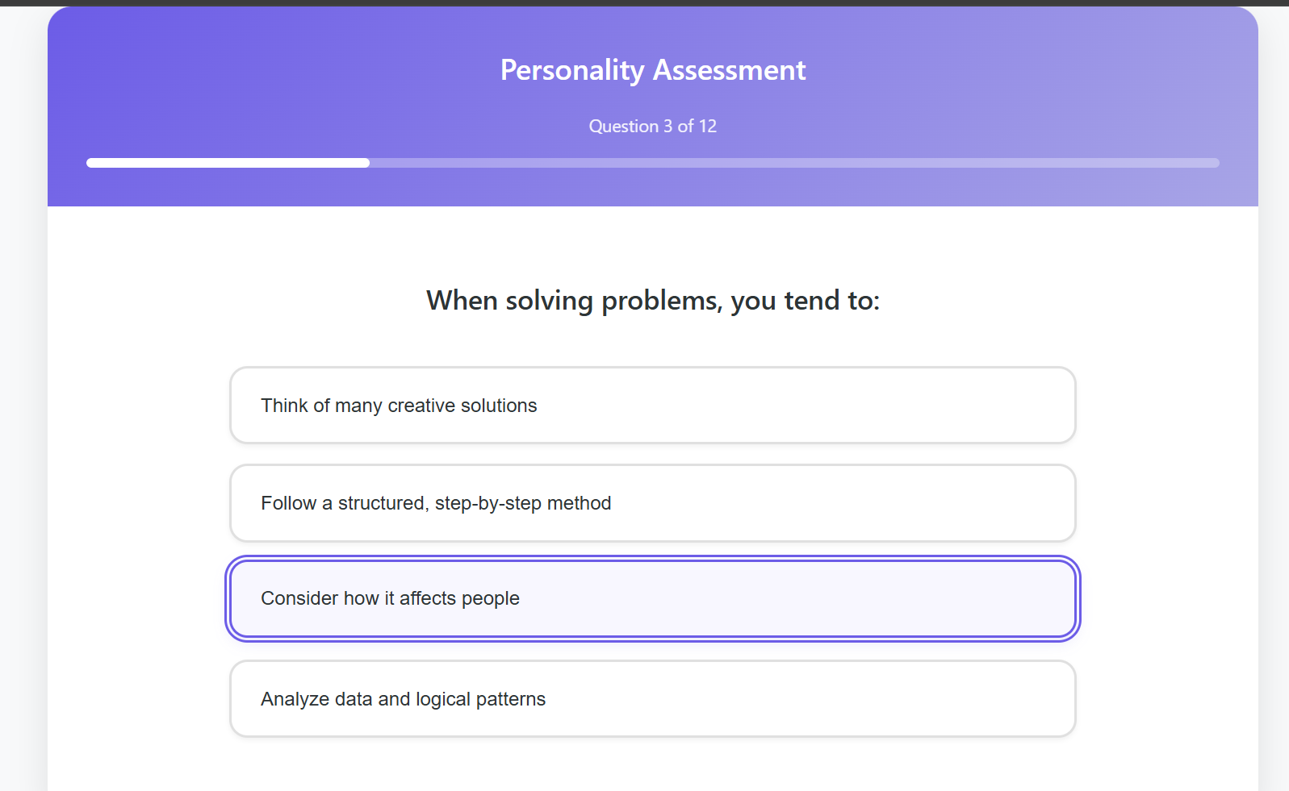
Module 1: User Authentication & Language Selection
Description:
Allows secure login/signup and lets users select a preferred language (English/Kannada).
Code/Logic Overview:
  JWT-based authentication for secure sessions.
  Stores user language preference in MongoDB.
  Dynamic UI rendering based on selected language.
Module 2: MBTI Personality Assessment
Description:
Predicts user's MBTI type using questionnaire and mBERT model.
Code/Logic Overview:
  Text summary of MCQ responses passed through mBERT model.
  Output MBTI type with confidence score.

Slide 13
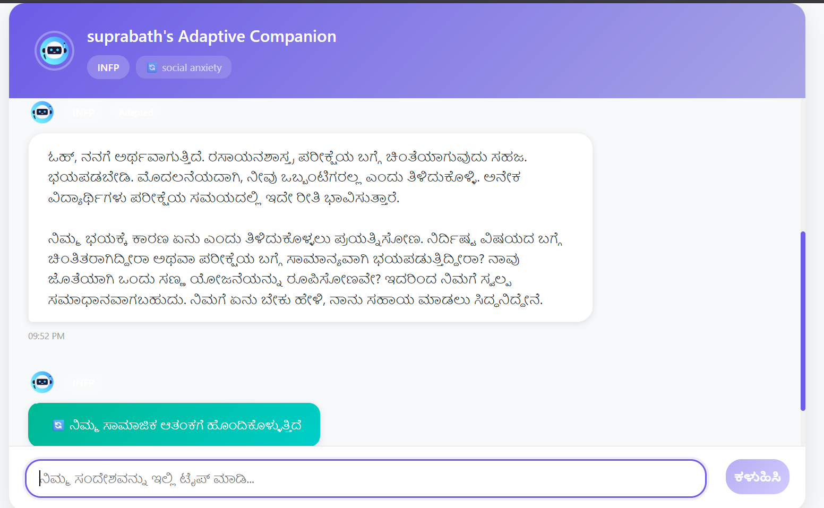
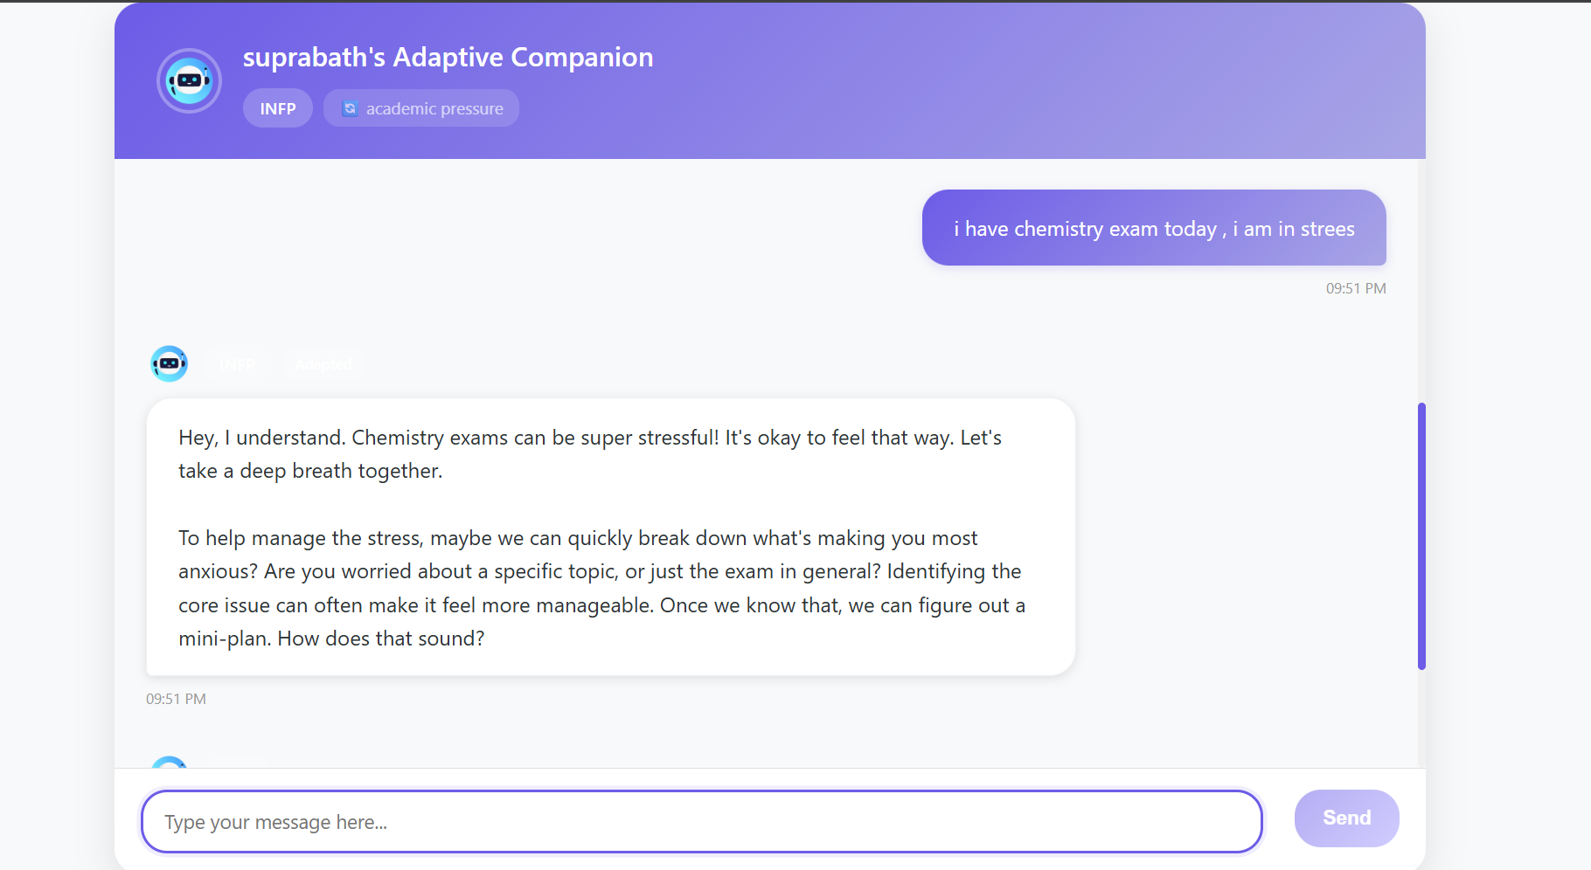
Module 3: Emotion Detection & Context Analysis
Description:
Classifies user emotions in real-time using DistilRoBERTa.
Code/Logic Overview:
  User input tokenized → passed to emotion classifier → detects emotion & academic context.
  Used to adapt chatbot tone/style.
Module 4: Personalized Response Generation
Description:
Generates adaptive replies using MBTI, emotion, and RL feedback.
Code/Logic Overview:
  adjusts response strategy.
  Combines MBTI + sentiment + history to generate output via Gemini API.

Slide 14
Proposed Solution
Your project introduces a dynamic, multi-layered methodology that integrates cognitive psychology principles with advanced machine learning techniques. It specifically aims to:
Develop a cognitive psychology-based user classification system using MBTI profiling and emotion analysis.
Implement a personalized response generation engine that adapts conversational style and support strategies based on detected emotional state, academic context, and user personality.
Enable cross-linguistic adaptation by providing culturally sensitive, emotion-aware responses in both English and Kannada. This involves using a transformer-based emotion classification engine (DistilRoBERTa) and a personality adaptation engine (MBTI profiling) to adapt conversational style and support strategies in real-time.
Justification
This approach is designed to better address the identified research gaps by moving beyond static, one-size-all conversational AI systems. It directly tackles the need for:
Enhanced personalization: By integrating MBTI and real-time emotion detection, it provides more tailored and empathetic interactions.
Multilingual and cross-cultural sensitivity: Offering support in both English and Kannada addresses the limitations in culturally and linguistically aware AI systems.
context adaptation: The system's ability to adjust responses based on immediate emotional states provides a more dynamic and effective support mechanism.
Context-specific relevance: Its focus on academic and mental health support for students fills a niche often overlooked by general-purpose chatbots.

Slide 15
Testing Methodology:
We performed functional testing on each module, including MBTI classification, emotion detection, and chatbot response generation. Inputs were provided in both English and Kannada to validate multilingual handling. We also tested end-to-end interaction flows to ensure logical consistency and personalized responses.
Results:
The chatbot responded appropriately to a variety of user inputs, including stress-related and casual messages.
It was able to identify personality traits and adapt responses across multiple test cases.
Kannada-language handling showed positive results in basic conversational scenarios..
Performance Observations:
Response time was consistent across test runs on a local machine.
Integration of Gemini API enhanced the naturalness of responses.
Emotion-based adjustments were triggered correctly in multiple test cases.

Slide 16
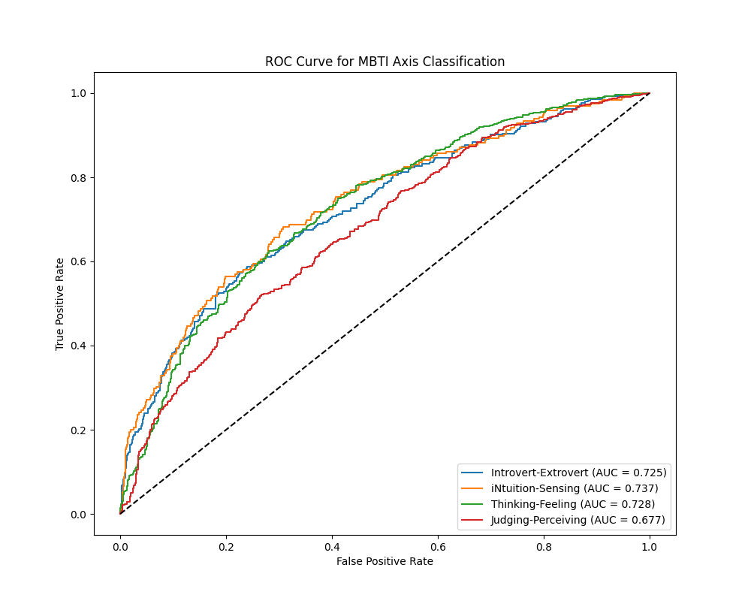
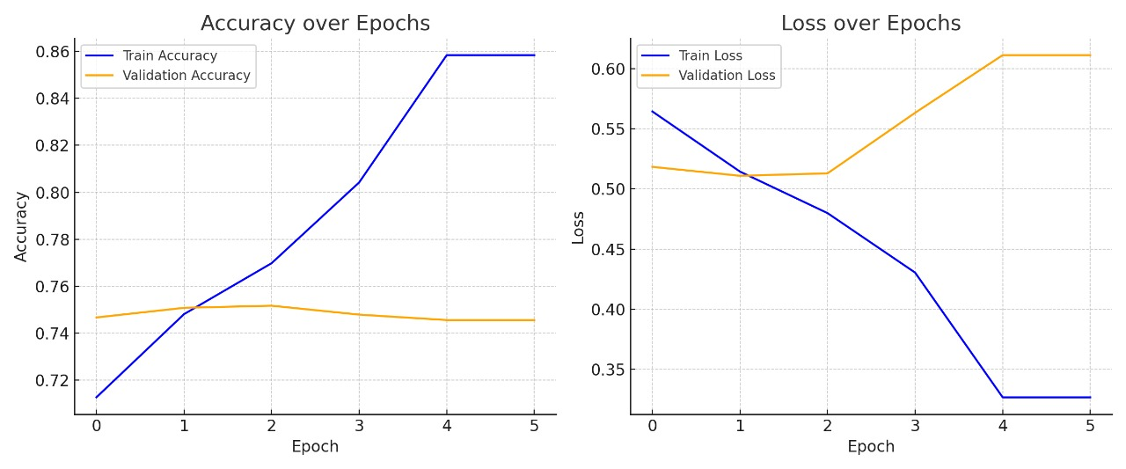
2. Results Snapshot and Description

Slide 17
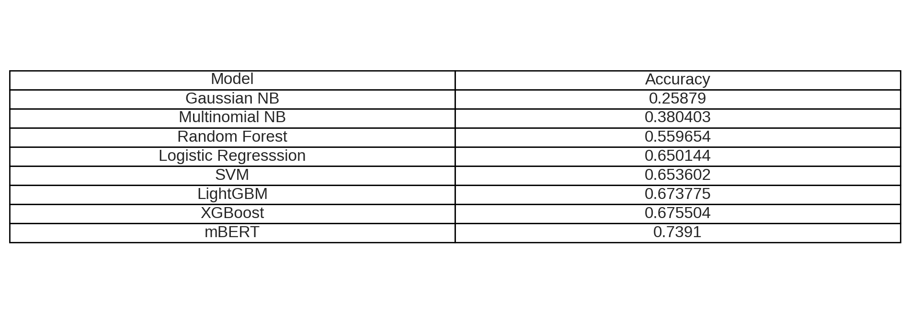
Comparison of existing model and mbert model

Slide 18
Challenges Faced:
Fine-tuning the mBERT model to understand both English and Kannada text effectively.
Accurately mapping user responses to MBTI personality types.
Ensuring smooth integration of different modules (chat engine, personality detection).
Generating meaningful responses in Kannada without grammar or tone issues.
How They Were Resolved:
Refined the MBTI mapping logic based on user input patterns and keyword analysis.
Modular testing and incremental integration helped manage system dependencies.
Used Gemini API and manual keyword filtering for improved Kannada outputs.

Slide 19
Limitations and Improvements
Current Limitations:
The chatbot accuracy depends on the quality of user input; short or unclear messages can affect personality detection.
Emotional understanding is not complex moods like sarcasm or mixed feelings.
Kannada support exists, but responses may struggle with informal or mixed-language input.
Future Improvements:
Integrate voice input and speech-based emotion recognition.
expand the the chatbot to different languages.

Slide 20
Conclusion
In this project, we developed a personalized chatbot that combines cognitive psychology and AI to offer meaningful conversations. The chatbot uses a multilingual BERT model to identify users' MBTI personality types and then adapts its responses accordingly. One of the highlights was making it work in Kannada, which helps address the language diversity that's often overlooked in AI systems.
The chatbot isn’t just rule-based — it understands emotional cues like stress or curiosity and changes how it replies, making interactions feel more thoughtful and real. With the help of Google’s Gemini API, we made the responses more natural and easier to connect with.
Overall, the chatbot did what we aimed for: it understood users better and responded in ways that felt relevant and engaging. We could see it being used in mental health, education, or even social platforms where understanding the user matters.

Slide 21
References
oBhowmick, S. S., Chen, S. H. A., & Srivastava, D. (2024). Cognitive psychology meets data management: State of the art and future directions. Companion of the 2024 ACM International Conference on Data Engineering (ICDE'24), 1–8.
o
Lex, E., & Schedl, M. (2022). Psychology-informed recommender systems: A human-centric perspective on recommender systems. Proceedings of the ACM Conference on Human Information Interaction and Retrieval (CHIIR'22), 1–7.
o
Henry, N. F. (2023). Modelling music selection in everyday life with applications for psychology-informed music recommender systems (Ph.D. thesis). University of Leeds
o
Kumar, A., & Sharma, A. (2021). A review on sentiment analysis and emotion detection from text. Journal of the Indian Institute of Science, 101(4), 435–448.

